Slide 1
Curriculum for the Training Course “Autism Spectrum Disorder (ASD) Officer”
https://www.autrain.eu/pt/curriculo/

Slide 2
BEGIN
Aim
Contents
Learning Outcomes
Il Cerchio
Activity: Brainstorming 1.1

Slide 3
Aim
Module 3: autism spectrum disorders and society
In this Unit we will explore useful strategies to engage with people with autism spectrum disorders in different given environments during typical routine and activities that promote academic skill, positive behaviors, problem solving and independence. Remember that each person is different, and specific tips may not apply to all.

Slide 4
Contents
Module 3: autism spectrum disorders and society
Addressing common challenges that a person with ASD may face: in a school, working place, public services, family/relationship
Different perspective/approaches to understand and deal with people with ASD.

Slide 5
Learning outcomes
Module 3: autism spectrum disorders and society
To discuss addressing common challenge person with ASD
To discuss to make autism friendly society
to identify critical elements of an inclusive society

Slide 6
Organization
Module 3: autism spectrum disorders and society
Estimated time to complete the module: 3 hours
Break: 30 minutes or two breaks of 10-15 minutes each

Slide 7
Organization
Begin 09:00 – 9:30 Aim Contents Learning outcomes Organization Activity: Brainstorming 3.1 | Develop 09:30 – 10:15 Addressing common challenges for ASD Activity: Think & Reflect 3.1 Making society ASD friendly
10:15 – 10:45 Beak time
Develop 10:45 – 11:30 Making society ASD friendly Activity: Think & Reflect 3.2 - language | End 11:30 – 12:00 Wrap up Activity: Real-world application 3.1 References & Resources Goodbye ☺

Slide 8
Activity: Brainstorming 3.1
“Listing / Mapping… ”

Slide 9
DEVELOP
Addressing common challenges for ASD
Making society ASD friendly at school
Activity:
Think & Reflect 3.1 neurodiversity making society asd friendly family, public services and work
Activity:
Think & Reflect 3.2

Slide 10
DEVELOP
Addressing common challenges for ASD
Making society ASD friendly at school
Activity: Think & Reflect 3.1

Slide 11
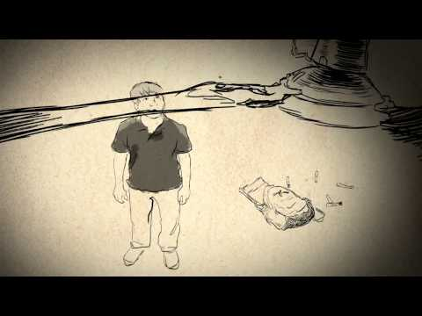
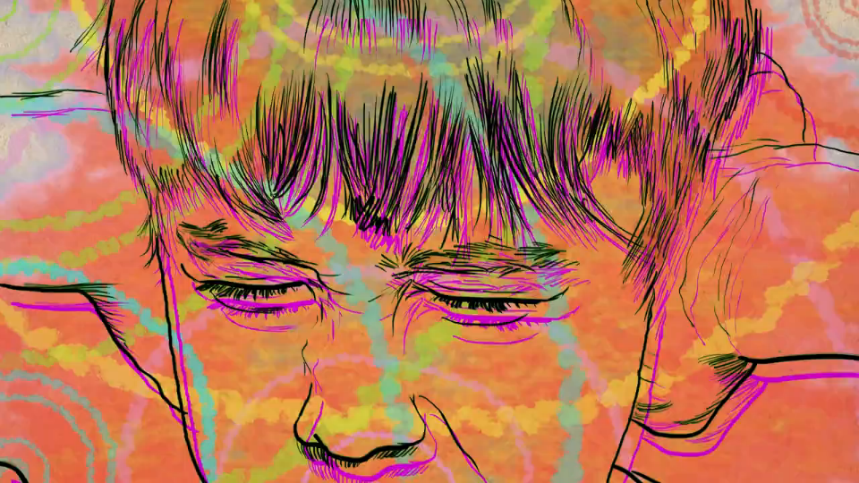
The most common challenges that autistic people must face in society are related to:
1. Sensory processing ( living in an intense world)
An autistic person processes sensory information from the surrounding world in an atypical way. This can sometimes causes over stimulation and make the world a chaotic place.

Slide 12
2. A different way of living relationship
Autistic people have a unique way of experiencing relationship but often do not understand the intricate world of neurotypical relationship.
All this, combined with a difficulty in the theory of mind and a different cognitive empathy, can create misunderstanding and can be a barrier to relationship in all life contexts (school, work, family, frienship).
https://www.youtube.com/watch?v=B0uYcgdvUXw

Slide 13
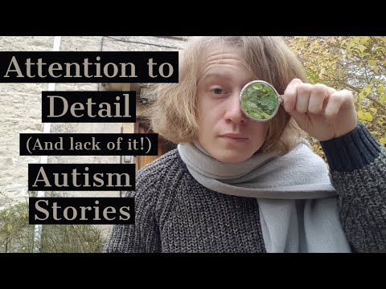
3.Attention to detail and atypicity in the central coherence
A great strength of autistic people is attention to detail, witch, however, can mean missing the big picture.
This can also mean a difficulty in understanding and making complex tasks without any prompt, and a difficulty in living in a multitasking world.

Slide 14
4.Just as biodiversity makes an environment richer, neurodiversity create a richer society
All this characteristics are extraordinary strength when viewed from the right perspective. It is not easy for an autistic person to live in a world designed for neurotypical people, but the world without neurodiversity would be less rich.
https://www.youtube.com/watch?v=q5PPYnJ1xc0
Our task is to create a world that is inclusive of all diversity and to
create a society ASD friendly.

Slide 15
5. We will meet in the middle of a bridge
Just as autistic people learn to live in a strange world
full of incomprehensible social rules,
society must also build communication bridges
to meet in the middle
So that no one is forced to change their uniqueness
and personalities.

Slide 16
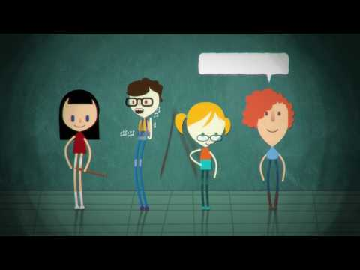
Activity: Think & Reflect 3.1 - neurodiversity
https://youtu.be/RbwRrVw-CRo

Slide 17
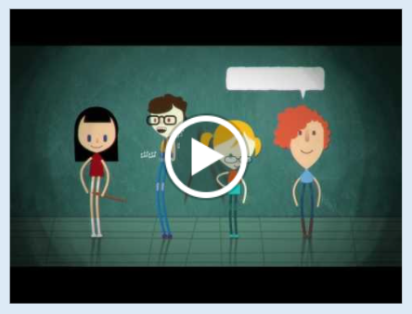
Activity: Think & Reflect 3.1 - neurodiversity
Questions/Discussion Topics:
What are your thoughts on what you have heard?
What is your idea of autism friendly society?
What do you think about neurodiversity? What is your idea of a welcoming society for neurodiversity?

Slide 18
Knowledge and culture of ASD
It is important that the culture of neurodiversity is taught in all
contexts of our society and to all kind of people (not only
professionals).
It is also very important to learn about ASD from the voice of
autistic people themselves.
Self advocacy.
https://www.youtube.com/watch?v=L4r5j44JR2M
This is the way to create an ASD Friendly society.

Slide 19
AUTISM AND SCHOOL
THE SCHOOL MUST KNOW HOW TO CREATE A WELCOMING ENVIRONMENT
YOU MUST BE ABLE TO IMPLEMENT SOME MEASURES EVEN BEFORE THE AUTISTIC CHILD OR YOUNG MAN ENTERS SCHOOL
YOU NEED A GOOD PASSAGE OF INFORMATION BETWEEN NEUROPSYCHIATRY AND SCHOOL OR BETWEEN SCHOOLS
TRAINING OF TEACHERS
TRAINING OF SCHOOL STAFF
EARLY IDENTIFICATION OF SUPPORT TEACHERS AND EDUCATORS

Slide 20
PREPARATIONE OF THE ENVIRONEMENT
STRUCTURING THE ENVIRONMENTS SO THAT THE FUNCTIONS OF THE VARIOUS PARTS OF THE CLASS ARE EASILY "READABLE AND USERABLE"
STRUCTURING THE CLASS AND FURNITURE SO THAT THE STUDENT IS IN THE CONDITIONS OF BEING ABLE TO MAKE REQUESTS
PREPARATION OF A MORE QUIET CORNER COMPARED TO THE REST OF THE CLASS

Slide 21
TO INSERT TASK ANALYSIS TO FACILITY AUTONOMY

Slide 22
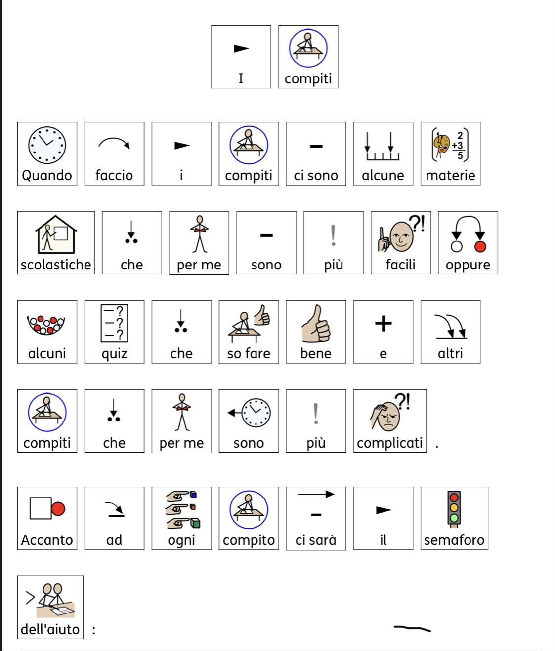
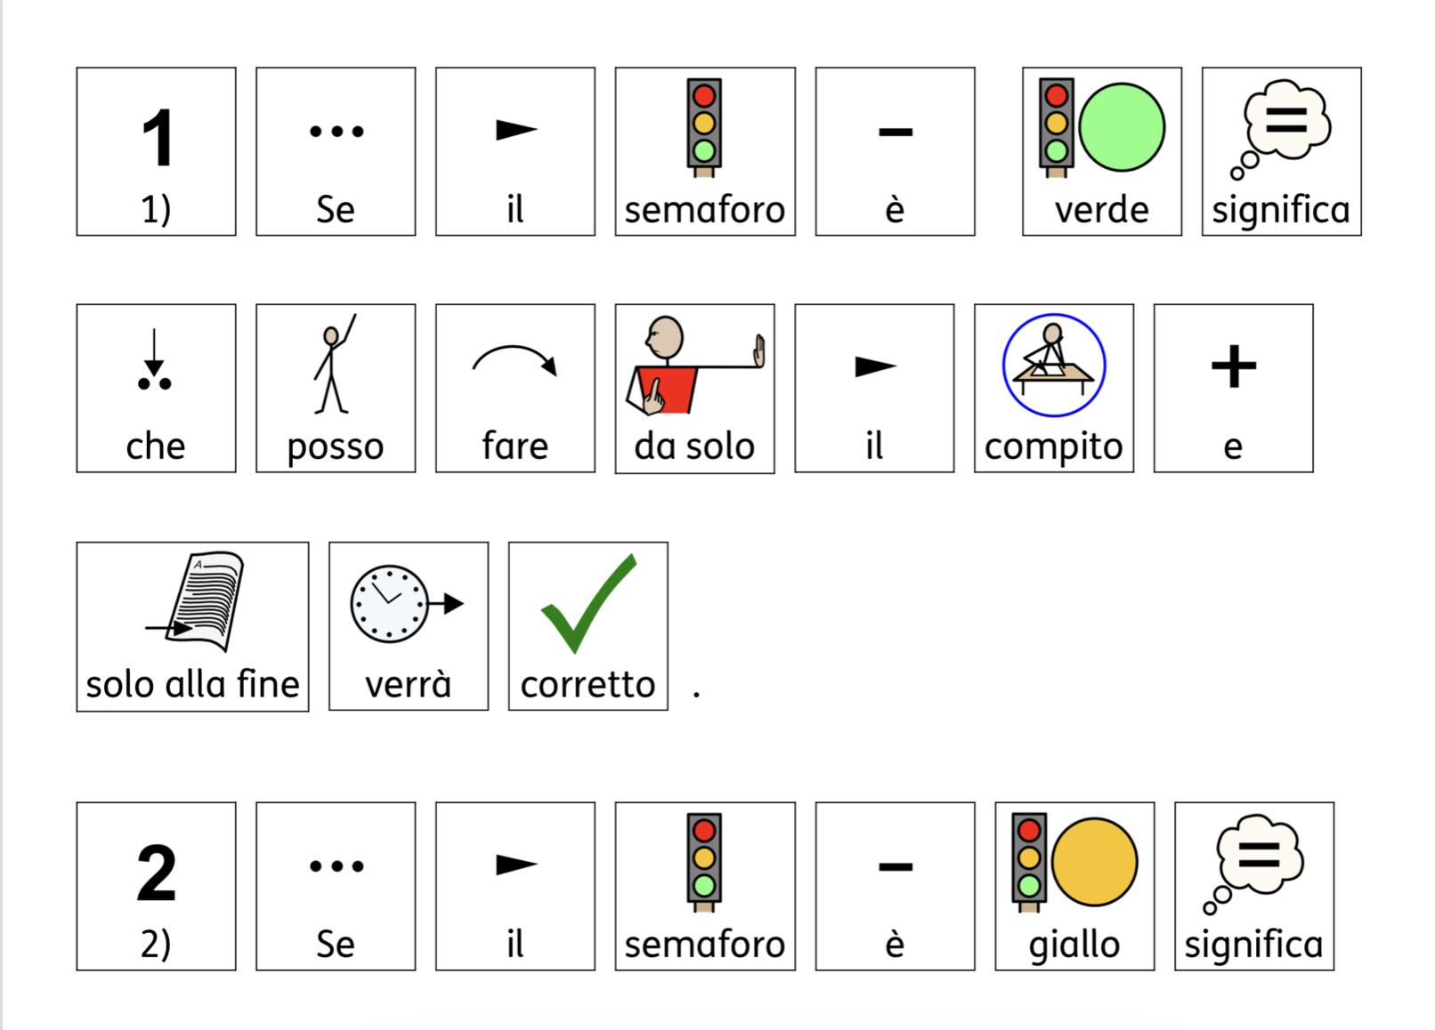
PREPARE SOCIAL STORIES FOR THE MANAGEMENT OF THE INCURRENT

Slide 23
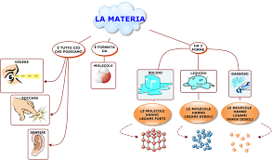
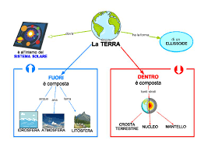
IDENTIFICATION OF THE STUDENT METHOD OF STUDY

Slide 24
ALSO LEND THE POSITION THAT THE STUDENT TAKES IN THE CLASSROOM

Slide 25
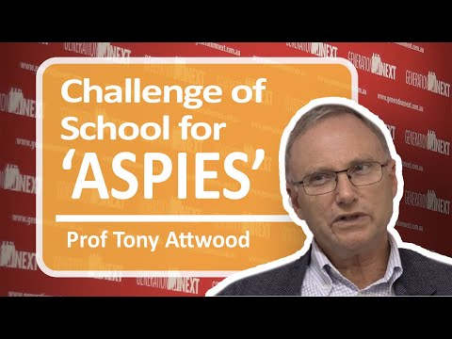
TONY ATWOOD TALK ABOUT SCHOOL AND ASPERGER

Slide 26
10:15 – 10:45
Break

Slide 27
DEVELOP
Makin society ASD friendly at family, public services and work
Activity: Teamwork

Slide 28
PERSON WITH ASD IN A PUBLIC SERVICES
STAFF TRAINING
An attendant on purpose
CLEAR AND SIMPLE LANGUAGE
VISUAL SUPPORTS
Video with situation in a shop, hospital Etc. (video-modeling)

Slide 29
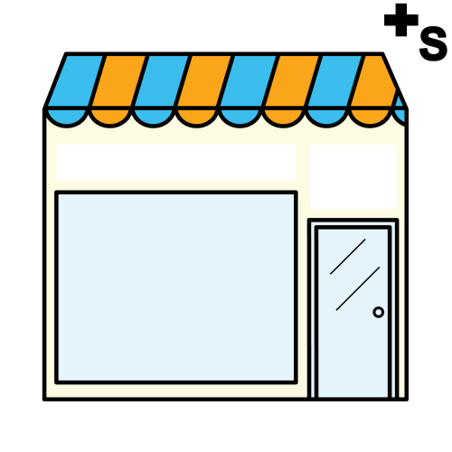
SHOPS AND LOCALS
Customized routes
Welcome the family in an appropriate way, waiting before asking for something
Have an isolated and little noisy space
Provide a task analysis on what will happen or on behaviors
Ask if there are any sounds or objects that can be annoying and ask if individualized strategies are already being used
Be quick to serve
https://youtu.be/cZ3qCXhe8t0

Slide 30
Draw the attention of the person and then prepare it before telling him anything
Observe the person carefully
Explain your actions, showing them on another or on themselves
Use simple language and concrete, consisting of short and clear sentences
Respect their need to keep distance and avoid physical contact when not strictly necessary.
Anticipate what you stand for to do with a few simple words, especially before touching the subject
Use simple images to explain what you are doing or communicate information consequentially

Slide 31
Relationship: T.O.M and atypicity in cognitive empathy
Having a theory of mind means being able to attribute mental states, that is, feelings, thoughts, beliefs and desires to oneself and to others in order to predict one's own and others' behavior.
The ability to reflect on our own thoughts and those of others is of crucial importance for human interaction, communication and socialization.
Cognitive empathy:
The cognitive component of empathy is based
instead on attributing emotional states to others
and identifying with a mental state of others.
How to teach that ability to ASD person?

Slide 32
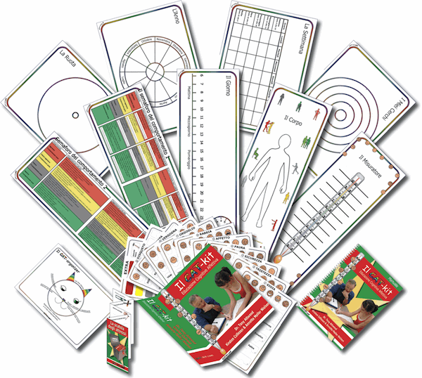
Relationship
How to deal relationship for an ASD person.
A very useful tool was created in Denmark that provides a visual structure
that can be used to clarify and identify appropriate communication of thought
and feelings.
It is also a very important tool to learn the theory of mind ( other people
thought and feelings) which are often not clear to ASD people.
https://www.youtube.com/watch?v=CkCM5_pLr4s

Slide 33
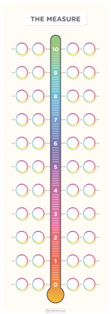
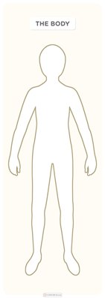
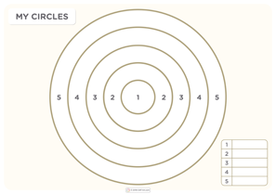

Slide 34
Fighting Depression in the ASD Tony atwood
Each action involves an expense or an energy recovery
It is important that there is always a balance between
these expenses and recoveries
In the face of demanding activities, just requests and
only recovery activities.
You give a number to each activity paying attention not
to what relaxes us but the student.

Slide 35
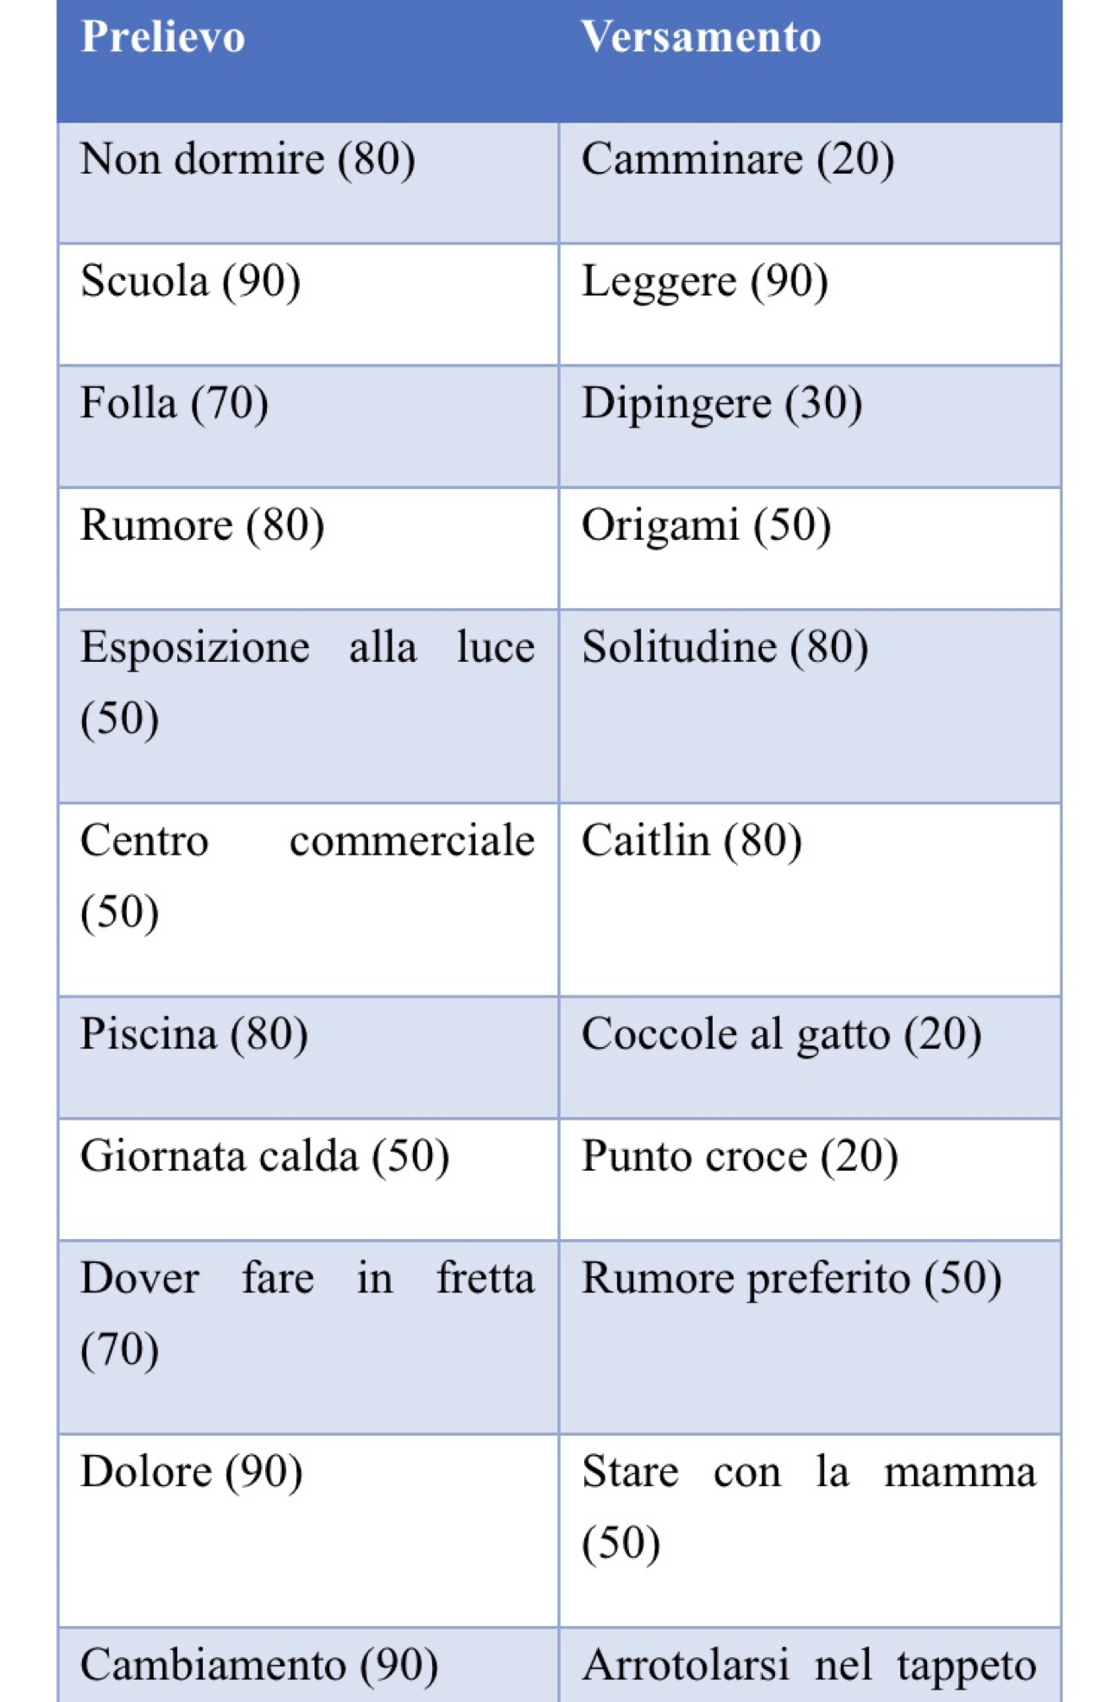
For a healthy life and to maintain good family, emotional and friend relationships it is important for an ASD person to recognize the energy costs that could lead to a meltdown and to plan relaxation activities.

Slide 36
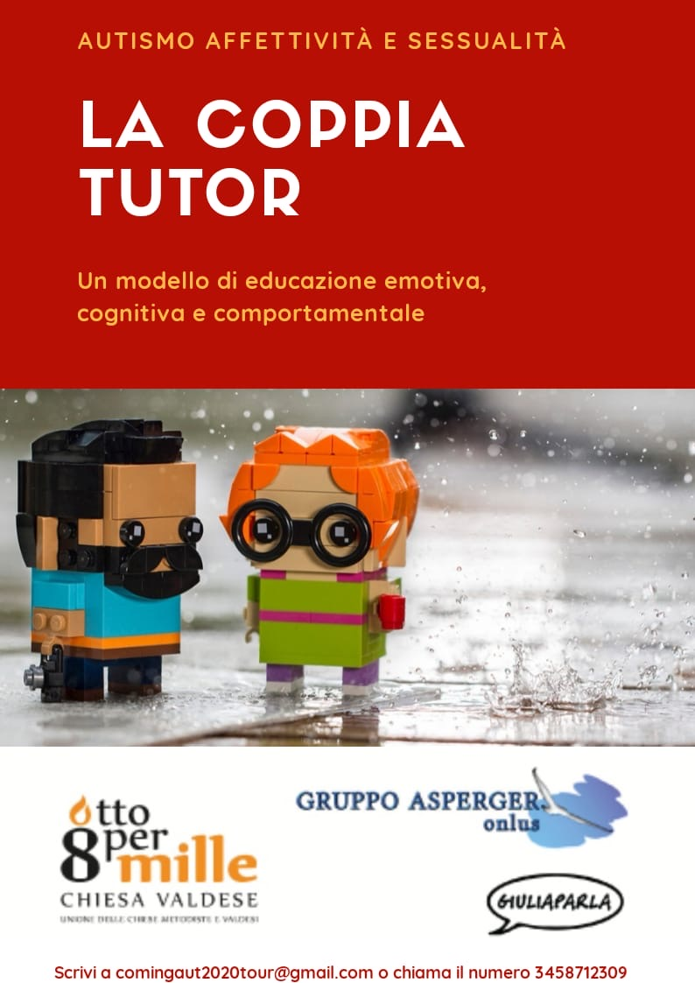
AUTISM, AFFECTIVITY AND SEXUALITY:
THE TUTOR COUPLE AS A MODEL OF ADAPTIVE BEHAVIOR "
TARGET EXPERIENCE AN INTERVENTION
ADDRESSED TO COUPLES OF PEOPLE WITH AUTISM
MEDIATED BY A COUPLE OF OPERATORS
FOR THE LEARNING OF SOCIAL AND RELATIONAL BEHAVIOR.
Gruppo Asperger Verona.

Slide 37
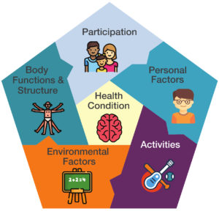
Functioning and not only diagnosis
ICF. International classification of functioning
https://www.youtube.com/watch?v=0Qn3OQvrkOs

Slide 38
ICF components and their contents
Functioning, disability and the components of the ICF
Body functions - The physiological functions of body systems (including psychological functions). Body structures - Anatomical parts of the body such as organs, limbs and their components. Impairments - Problems in body function and structure such as significant deviation or loss.
Activity - The execution of a task or action by an individual.
Participation - Involvement in a life situation.
Activity limitations - Difficulties an individual may have in executing activities.
Participation restrictions - Problems an individual may experience in involvement in life situations.
Environmental factors - The physical, social and attitudinal environment in which people live and conduct their lives. These are either barriers to or facilitators of the person's functioning.

Slide 39
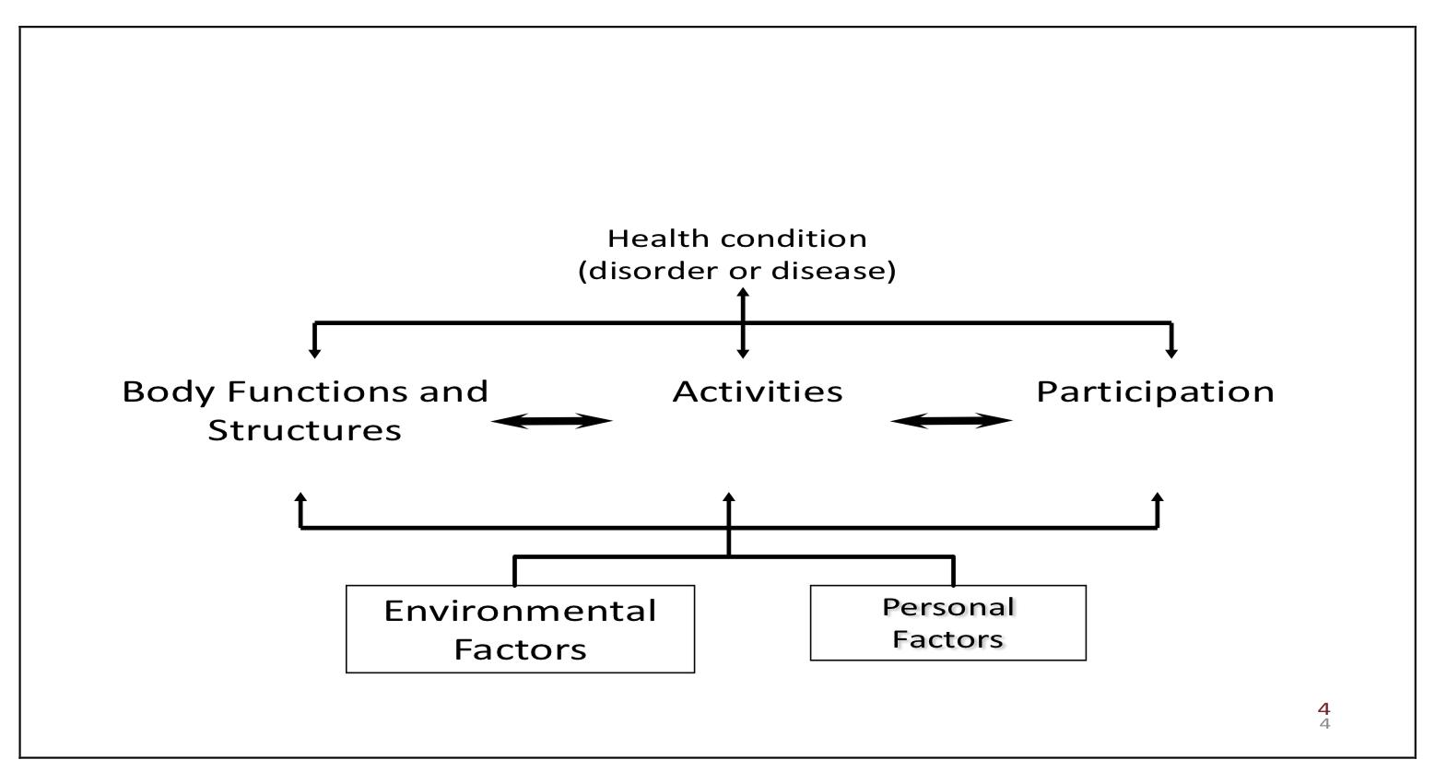

Slide 40
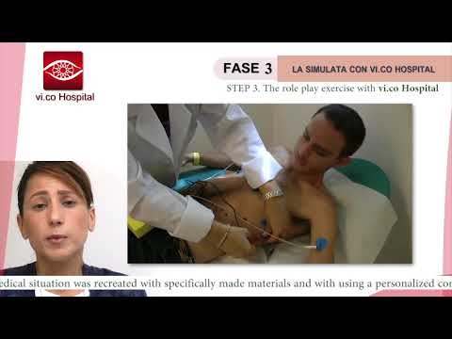
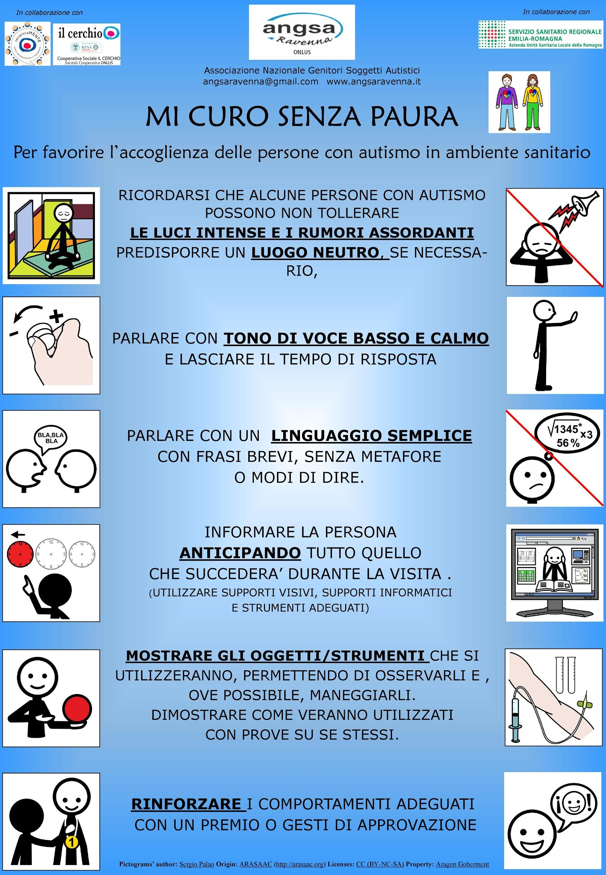
https://salute.regione.emilia-romagna.it/normativa-e-documentazione/convegni-e-seminari/conferenza-regionale-salute-mentale-29-30-ottobre-2007/autismo-che-fare-emilia-romagna-a-confronto-con-le-altre-regioni-italiane-sui-modelli-di-intervento-1
fare-emilia-romagna-a-confronto-con-le-altre-regioni-italiane-sui-modelli-di-intervento-1
https://www.bambinieautismo.org/manuale_del_soccorritore.pdf
https://www.bambinieautismo.org/una-stanza-in-ospedale-dedicata-alle-persone-
con-autismo/
https://daily.veronanetwork.it/news/autismo-a-verona-il-primo-protocollo-per-negoz-e-locali/

Slide 41
At work
The presence of a transitional educator is necessary to help the person with ASD in these moments:
contact the companies and identify the suitable company
evaluate the working context
hold meetings to get closer to the company
information and training on ASDs
meetings with consultant, person and and educator
regular comparison

Slide 42
How to set up the work area
Structuring and organizing activities according to the priorities of the azeinda
define the necessary aids and adaptations in the workplace
definition of the attic
presence of the educator who fades with time
regular meetings between educator person with ASD or educators and company staff

Slide 43
Tools at work:
prepare a work agenda (what should I do now ?, where ?, who ?, when does the activity I have to do last? what should I do next? etc.)
structure and organize activities
table to improve business processes
evaluation of objectives

Slide 44
Activity: teamwork autism friendly society
IN A SMALL GROUP TO CREATE A SOLUTION OF A SITUATION IN A SCHOOL, IN PUBLIC SERVICE ECC
After having seen the above information, discuss in groups:
What are the ways to allow people with ASD to be autonomous in carrying out activities in public services?
What are the proper ways to create a relationship with a person with autism?
what are the possible practices in the school?

Slide 45
END
Wrap up
Activity: Real-world application 3.1
References & Resources
Questions? Goodbye & Thanks ☺

Slide 46
Activity: Real-world application 3.1
Questions for reflection:
Can you remember the most common problems a person with ASD?
What may be other problems or difficulties of people with ASD in the contexts treated?
Now think about one of the places covered, such as school, public services or relationships. According to what we have learned, what can be other obstacles to an ASD? what can be other ideas to help them in their autonomy in these contexts? what would exist obstacles for a new employee with ASD?

Slide 47
References
Atwood, T. (2008). The complete guide to Asperger's Syndrome. Jessica Kingsley Publishers.
Beukelman, D. R. & Mirenda, P. (2014). Di comunicazione aumentativa e alternativa. Interventi per bambini e adulti con complessi bisogni comunicativi. Centro Studi Erickson.
Bogdashina, O. (2016). Sensory perceptual issues in Autism and Asperger Syndrome. Jessica Kingsley Publishers.
Gray, C. (2015) The new social story book: Over 180 social stories that teach everyday social skills to children and young adults with Autism or Asperger's Syndrome, and Their Peers. Future Horizons.
Gray, C. (2015). The new social story book. Future Horizons Incorporated.
Howlin, P. (1988). Teaching children with Autism to mind-read-Read: A practical guide for teachers and parents. Wiley.
https://apps.who.int/iris/bitstream/handle/10665/43737/9789241547321_eng.pdf;jsessionid=F031A93B4FA1959893D860EF9E627368?sequence=1
https://cat-kit.com/it/
http://www.spazioasperger.it/
https://www.fondazioneares.com/

Slide 48
Questions?
Goodbye &
Thanks for coming ☺
The European Commission support for the production of this publication does not constitute an endorsement of the contents which reflects the views only of the authors, and the Commission cannot be held responsible for any use which may be made of the information contained therein.

Slide 49
Curriculum for the Training Course “Autism Spectrum Disorder (ASD) Officer”
https://www.autrain.eu/pt/curriculo/

