Slide 1
Curriculum for the Training Course
“Autism Spectrum Disorder (ASD) Officer”
https://www.autrain.eu/pt/curriculo/

Slide 2
BEGIN
Aim
Contents
Learning Outcomes
Organization
Activity: Brainstorming 1.1

Slide 3
Aim
Module 1: Creating an inclusive society
To develop and extend skills in understanding the rationality of an inclusive society and its significance for the success and well-being of people with Autism Spectrum Disorder

Slide 4
Contents
Module 1: Creating an inclusive society
Inclusion from different perspectives
Critical elements for creating an inclusive society
Common terminology/ range of views on ASD-friendly language

Slide 5
Learning outcomes
Module 1: Creating an inclusive society
To discuss the nature of inclusion
to identify critical elements of an inclusive society
To understand the person versus identity - first language

Slide 6
Organization
Module 1: Creating an inclusive society
Estimated time to complete the module: 3 hours
Break: 30 minutes or two breaks of 10-15 minutes each

Slide 7
Organization
Begin 09:00 – 9:30 Aim Contents Learning outcomes Organization Activity: Brainstorming 1.1 | Develop 09:30 – 10:15 Inclusion from different perspectives Critical elements for creating an inclusive society Activity: Think & Reflect 1.1 - inclusion
10:15 – 10:45 Beak time
Develop 10:45 – 11:30 Common terminology/ range of views on ASD-friendly language Activity: Think & Reflect 1.2 - language | End 11:30 – 12:00 Wrap up Activity: Real-world application 1.1 References & Resources Goodbye ☺

Slide 8
Activity: Brainstorming 1.1
“Listing / Mapping… ”

Slide 9
DEVELOP
Inclusion from different perspectives
Critical elements for creating an inclusive society
Activity: Think & Reflect 1.1 – inclusion
Common terminology/ range of views on ASD-friendly language
Activity: Think & Reflect 1.2 - language

Slide 10
DEVELOP
Inclusion from different perspectives
Critical elements for creating an inclusive society
Activity: Think & Reflect 1.1 - inclusion
Common terminology/ range of views on ASD-friendly language
Activity: Think & Reflect 1.2 - language

Slide 11
Inclusion from different perspectives
“Since the 1069s we have seen dramatic changes in the quality of lives of people with disabilities, including increased presence and participation in the community” (Talylor, et al., 1996, p. 279)
There is a long history towards inclusion, which started with exclusion from the community and ends in ongoing transformation process to a better society (Martins, 2000)

Slide 12
Inclusion from different perspectives
“Opportunities for independent living, daytime activities and employment are important aspects of social inclusion and participation in the community” (Gray, 2014, p. 2013)
The United Nations Convention on the Rights of Persons with Disabilities recognize the equal right of all persons with disabilities to live in the community, with choices equal to others, and shall take effective and appropriate measures to facilitate full enjoyment by persons with disabilities of this right and their full inclusion and participation in the community (United Nations, 2006)

Slide 13
Critical elements for creating an inclusive society
Celebrates diversity, promotes fraternity and equality of opportunity (Thomas, 1997)
Makes all feel valued, safe, connected, and cared for (Schaffner & Buswell, 1996)
Respects and promotes equality as a value (Karagiannis et al., 1996)
Requires positive attitudes toward people with disabilities (Thomas, 1997)

Slide 14
Critical elements for creating an inclusive society
Is barrier-free, it is accessible to all (Thomas et al., 1998)
Is ethically, morally, and legally just (Karagiannis et al., 1996).
Celebrates participation and empowerment (Karagiannis et al., 1996)
Develops support networks (Schaffner & Buswell, 1996)

Slide 15
Critical elements for creating an inclusive society
Requires a strong public commitment to stop “many barriers that vary according to the cultural and economic structures of communities” (Dillenburger, 2015, p. 330 )
Requires a “commitment to inclusive ideals communicated across the school and into the community” (Kugelmass, 2006, as cited in McMaster, 2006, p. 42)
Requires “an uncompromising commitment and belief in inclusion” (Kugelmass, 2006, as cited in McMaster, 2006, p. 42)

Slide 16
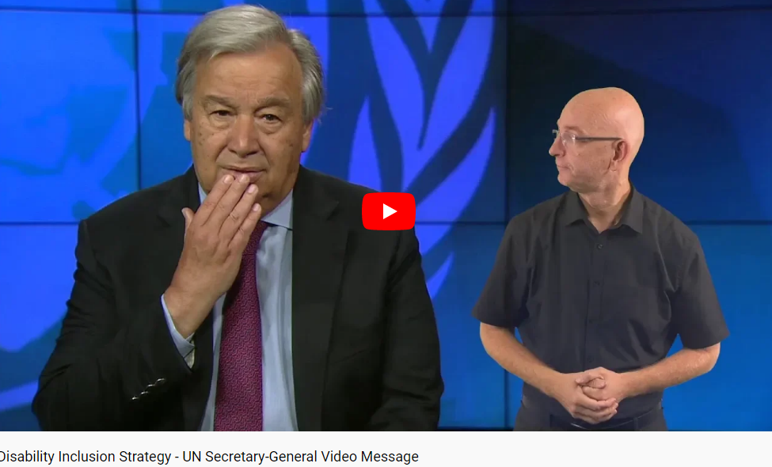
Activity: Think & Reflect 1.1 - inclusion
United Nations Disability Strategy
Let’s watch the UN secretary-General:
https://www.youtube.com/watch?v=LDbPgSWwEuU&feature=emb_logo

Slide 17
Activity: Think & Reflect 1.1 - inclusion
Questions/Discussion Topics:
What are your thoughts on what you have heard?
What is your idea of inclusion?
What kind of world wants the secretary to plan for the future? What do you fell about it? Does it fit in your idea of inclusion?

Slide 18
Activity: Think & Reflect 1.1 - inclusion
There are more than one billion people with disabilities in the world
Considering inclusion and the rights of people with disabilities is a matter of justice and an investment in our common future
Agenda 2030- Leave no one behind
A world in which all people, including the ones with disabilities, can enjoy equal opportunities, have a full say in decision-making processes, and truly benefit from economic, social, political and cultural life
All together we can build an inclusive, accessible and sustainable world for all

Slide 19

10:15 – 10:45
Break
The European Commission support for the production of this publication does not constitute an endorsement of the contents which reflects the views only of the authors, and the Commission cannot be held responsible for any use which may be made of the information contained therein.

Slide 20
DEVELOP
Inclusion from different perspectives
Critical elements for creating an inclusive society
Activity: Think & Reflect 1
Common terminology/ range of views on ASD-friendly language
Activity: Think & Reflect 2

Slide 21
Common terminology/ range of views on ASD-friendly language
“People with disabilities express some strong feelings about the words and phrases used to describe them. This issue is very important to people with disabilities, because words send a message to others about our respect for them
Language evolves to reflect changing concepts and beliefs, and some things that people say may have been socially acceptable at one point in history but offensive at another. (…) In most cases, they were not originally thought of as harmful, but they took on negative connotations
As a result of grassroots advocacy, people with disabilities and their families have influenced the language we use to refer to members of this minority group” (Smith, 2007, pp. 17-18)

Slide 22
Common terminology/ range of views on ASD-friendly language
Many communities of people with disabilities use person-first language, advocating that we should put people first and do not make the person equal to the disability (Smith, 1998)
Many self-advocates, as well as scholars, consider identity-first language due to:
“(a) autism is a central, identity-defining feature that cannot be separated from the individual, and
(b) the use of person-first language might perpetuate stigmatizing views, as desirable attributes are normally expressed through pronouns preceding nouns (e.g., “a smart child”), and alternative linguistic constructions might suggest undesirable attributes” (Vivanti, 2020, p. 691)

Slide 23
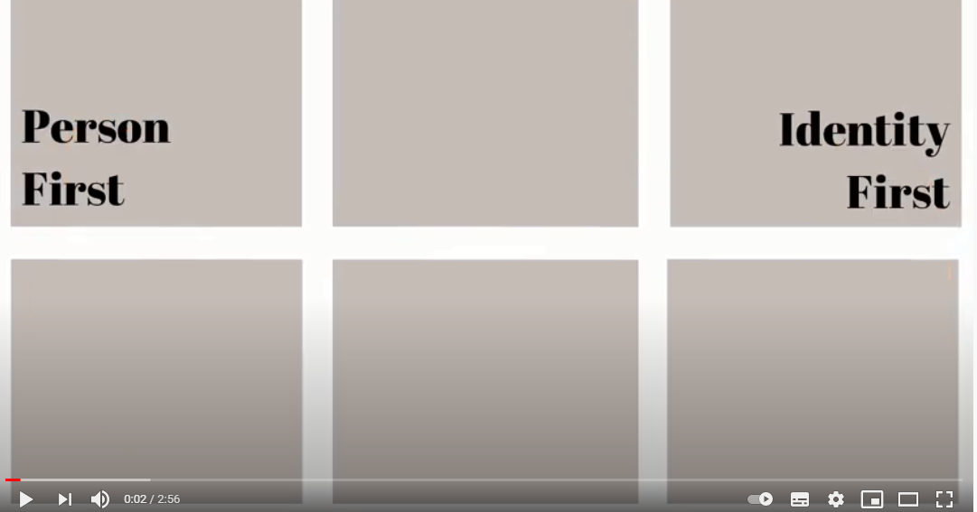
Activity: Think & Reflect 1.2 - language
Let’s watch the video:
https://www.youtube.com/watch?v=-LX0KI4xkco

Slide 24
Activity: Think & Reflect 1.2 - language
Person versus identity first language
Questions/Discussion Topics:
What thoughts did you have during these video with two different perspectives in what concerns friendly language?
What major models are linked to these two different perspectives? Explain
How important do you think it is that officers are aware of diversity of language when contacting people with ASD? Explain your answer
How important do you think it is that officers use appropriate language when contacting people with ASD? Explain your answer

Slide 25
Activity: Think & Reflect 1.2 - language
Finally, consider to (Vivanti, 2020) :
Address the concerns of disability groups while promoting human dignity and maintaining scientific and professional rigor
Take the preferences of clients/students/friends/etc. into account
Reflect a common intent to de-pathologize autism and inspire respect
Consider how different linguistic formulations relate to different historical agendas, priorities and experiences of different groups and individuals within the autism community

Slide 26
Activity: Think & Reflect 1.2 - language
Finally, consider:
Be aware that the “words used to describe individuals with ASD influence societal perceptions, public policy, clinical practice and research directions” (Vivanti, 2020, p. 691)
“The priority of research should be to centre autistic people (both speaking and non-speaking, and with, and without learning disabilities) in the conversation around the language used to describe autism and autistic people” (Botha, 2020, online)

Slide 27
END
Wrap up
Activity: Real-world application 1.1
References & Resources
Questions? Goodbye & Thanks ☺

Slide 28
Wrap up
Inclusion is a right and a responsibility
Inclusion works to the benefit of all
Terminology will continue to change
Not every member of every group agrees with these terminology choices
Officers who are aware of these issues and who exhibit thoughtfulness and sensitivity when referring to individuals with ASD can avoid offending students and their families

Slide 29
Activity: Real-world application 1.1
Questions for reflection:
a. What were my assumptions about the topic?
b. Where do the assumptions I had about the topic come from?
c. How my assumptions about the topic are the same or different from when you started this module?
d. What surprised me? What annoyed me?
e. How will I accommodate this knowledge in my workplace?
f. What major barriers do I find in my workplace in order to people with ASD be effectively included? Explain.

Slide 30
References
Botha, M., Hanlon, J. & Williams, G.L. (2021). Does Language Matter? Identity-First Versus Person-First Language Use in Autism Research: A Response to Vivanti. Journal of Autism and Developmental. Online. https://doi.org/10.1007/s10803-020-04858-w
Dillenburger, K., McKerr, L., Jordan, J. A., Devine, P., & Keenan, M. (2015). Creating an Inclusive Society… How Close are We in Relation to Autism Spectrum Disorder? A General Population Survey. Journal of Applied Research in Intellectual Disabilities, 28(4), 330-340. https://doi.org/10.1111/jar.12144
Schaffner C.B. & Buswell, B.E. (1996). Ten critical elements for creating inclusive and effective scholl communities. In S. Stainback & W. Stainback (Eds.). Inclusion: A guide for educators (pp. 49-66). Paul Brookes.
Smith, D. D. (2007). Introduction to special education: Making a difference. Boston: Allyn and Bacon.
McMaster, C. (2006). Elements of inclusion: Findings from the Field. Kairaranga, 15(1), 42-49.
Thomas, G. (1997). Inclusive schools for an inclusive society. British Journal of Special Education, 24 (3), 103-107.

Slide 31
References
Thomas, G., Walker, D., Webb, J. (1998). The making of the inclusive school. Routlege.
Karagiannis, A., Stainback, & W. Stainback (1996). Rationale for inclusive schooling. In S. Stainback & W. Stainback (Eds.). Inclusion: A guide for educators (pp. 3-16). Paul Brookes.
United Nations (1996). Report of the World Summit for Social Development, 1995. Author.
United Nations (2006). Convention on the Rights of Persons with Disabilities (UNCRPD) (2006) .. Available at: https://www.un.org/development/desa/disabilities/convention-on-the-rights-of-persons-with-disabilities.html. (accessed on 8 February 2021).
Vivanti, G. (2020). Vivanti, G. ask the editor: What is the most appropriate way to talk about individuals with a diagnosis of autism?. Journal of Autism and Developmental Disorders, 50, 691–693. https://doi.org/10.1007/s10803-019-04280-x
Waltz, M., Bosch, K., Ebben, H., Hal, L., & Schippers, A. (2015) Autism self-advocacy in the Netherlands: Past, present and future. Disability & Society, 30 (8), 1174-1191. DOI: 10.1080/09687599.2015.1090954
Waltz, M., Bosch, K., Ebben, H., Hal, L., & Schippers, A. (2015) Autism self-advocacy in the Netherlands: Past, present and future. Disability & Society, 30 (8), 1174-1191. DOI: 10.1080/09687599.2015.1090954

Slide 32
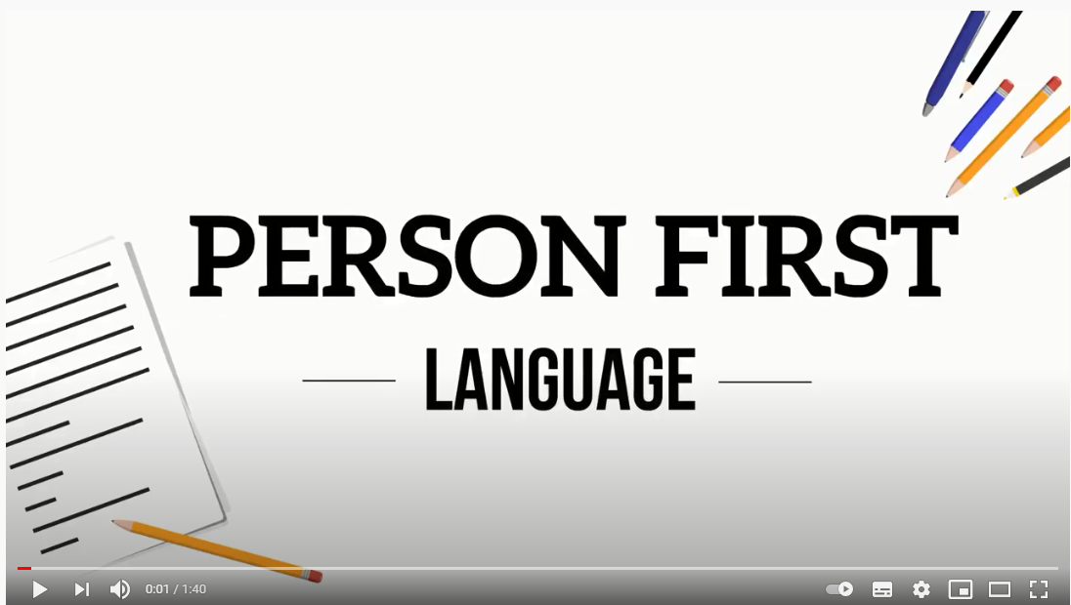
Helpful resources
Inclusive communication (Read the guidelines presented on p. 10)
https://www.consilium.europa.eu/media/35446/en_brochure-inclusive-communication-in-the-gsc.pdf
Acceptable language:
https://www.autismeurope.org/about-autism/acceptable-language/
Language (Special Olympics movement):
https://www.youtube.com/watch?v=obbwb1bJ5io&feature=emb_logo

Slide 33
Helpful resources
United Nations Disability Strategy:
https://www.un.org/en/content/disabilitystrategy/
The Nations Convention on the Rights of Persons with Disabilities:
https://www.un.org/development/desa/disabilities/convention-on-the-rights-of-persons-with-disabilities/convention-on-the-rights-of-persons-with-disabilities-2.html
Autism Europe website:
https://www.autismeurope.org/
European Agency for Special Needs and Inclusive Education website
https://www.european-agency.org/

Slide 34

Grant Agreement: 2019-1-AT-KA202-051218
Questions?
Goodbye &
Thanks for coming ☺
The European Commission support for the production of this publication does not constitute an endorsement of the contents which reflects the views only of the authors, and the Commission cannot be held responsible for any use which may be made of the information contained therein.

Slide 35
Curriculum for the Training Course
“Autism Spectrum Disorder (ASD) Officer”
https://www.autrain.eu/pt/curriculo/

